Slide 1
Why Statistics is the Foundation of Data Science
Dr. Tirthajyoti Sarkar
August 31st, 2019

Slide 2
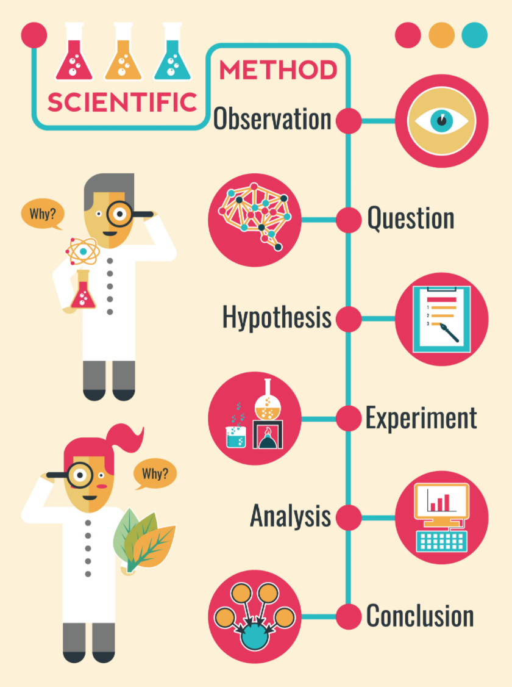
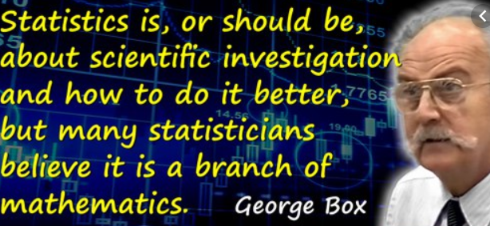
Statistics and the ‘Scientific Method’

Slide 3
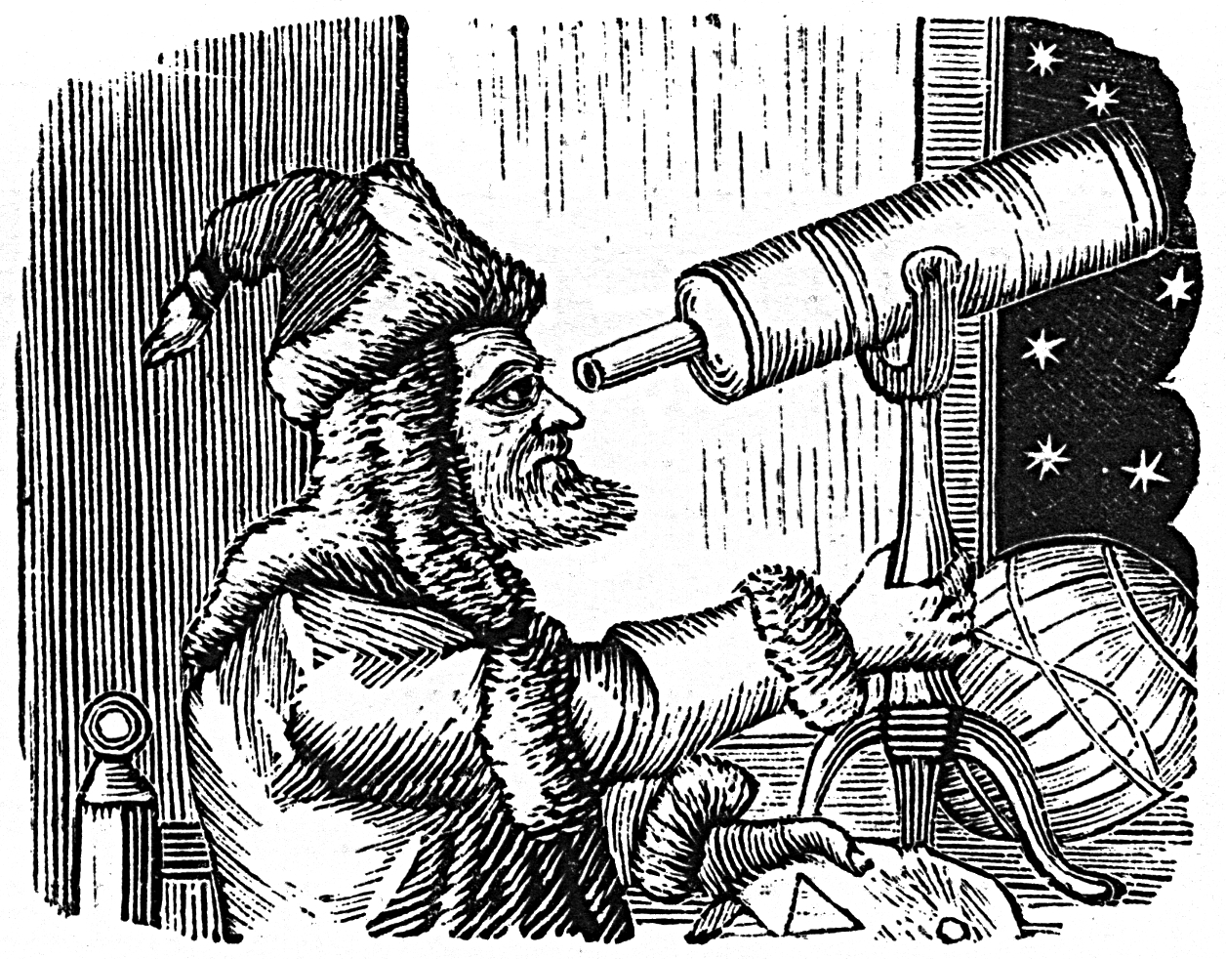
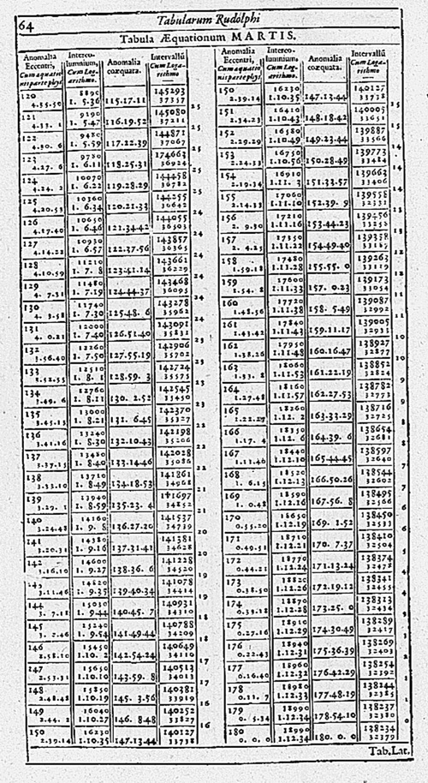


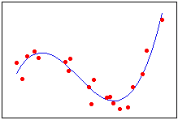
Example of Data Science in 17th century...
The modern science was kickstarted - using data table, and curve fitting...

Slide 4
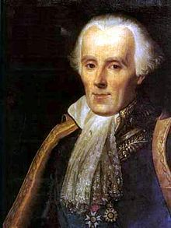
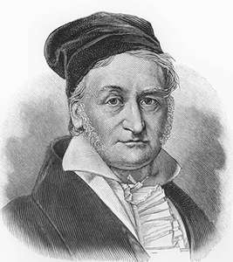
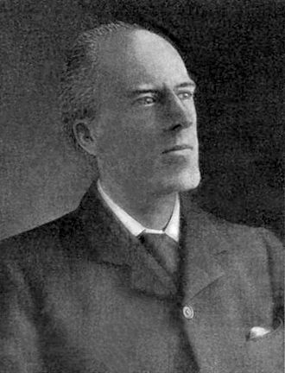
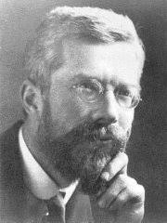

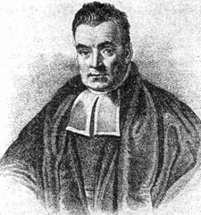
A brief history of statistics...
Middle of 18th century
19th century
20th century
Tax, economy, military data collection
Probability, uncertainty, mathematical foundation
Inference, prediction, modern concepts

Slide 5
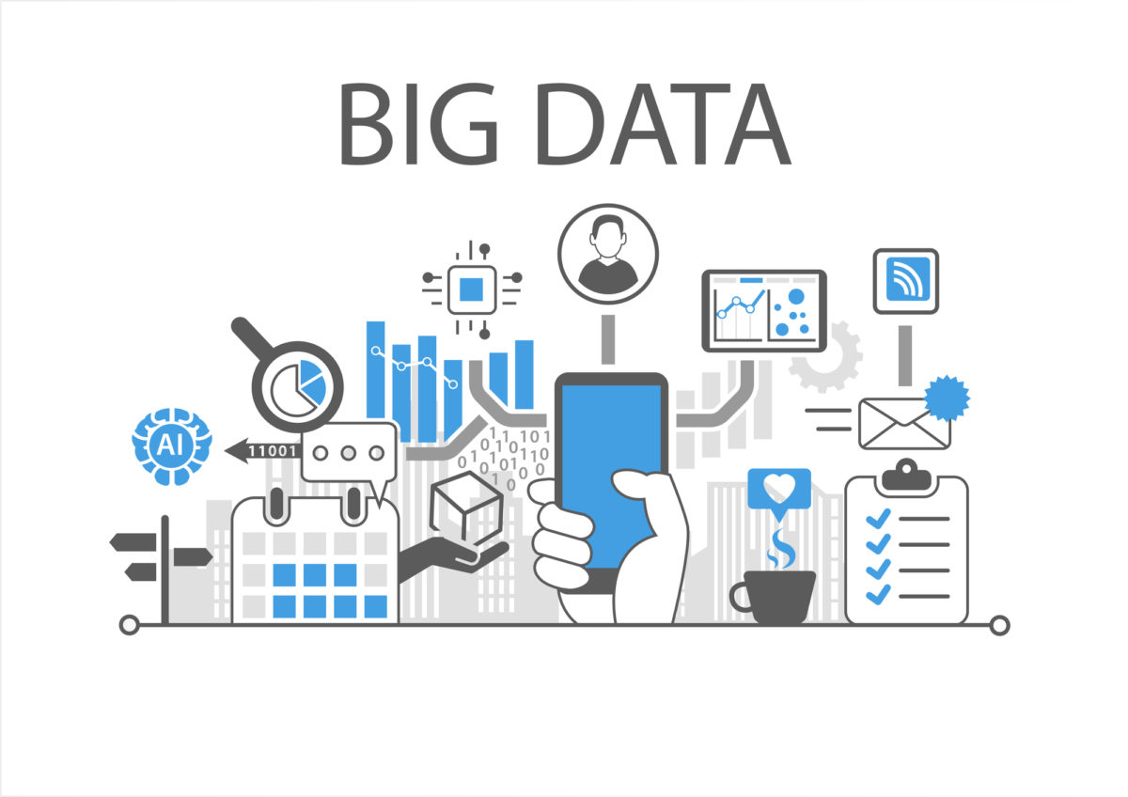
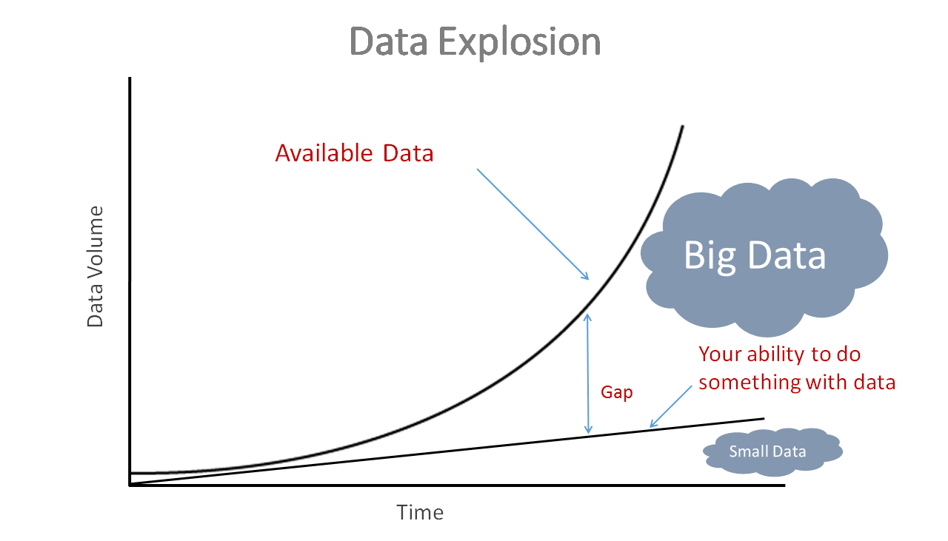
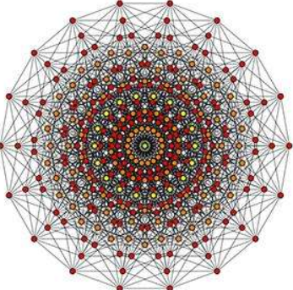

Why is statistics ‘hot’ today?
High-dimension
But statistics was developed to handle ‘Small Data’
Incredibly rich and mathematically sound modeling and prediction techniques
Standard way to deal with uncertainty
Fast, ‘good enough’ alternative to model data w/o using heavy computation
Bayesian approach fits naturally with the mantra of ‘update your belief’

Slide 6





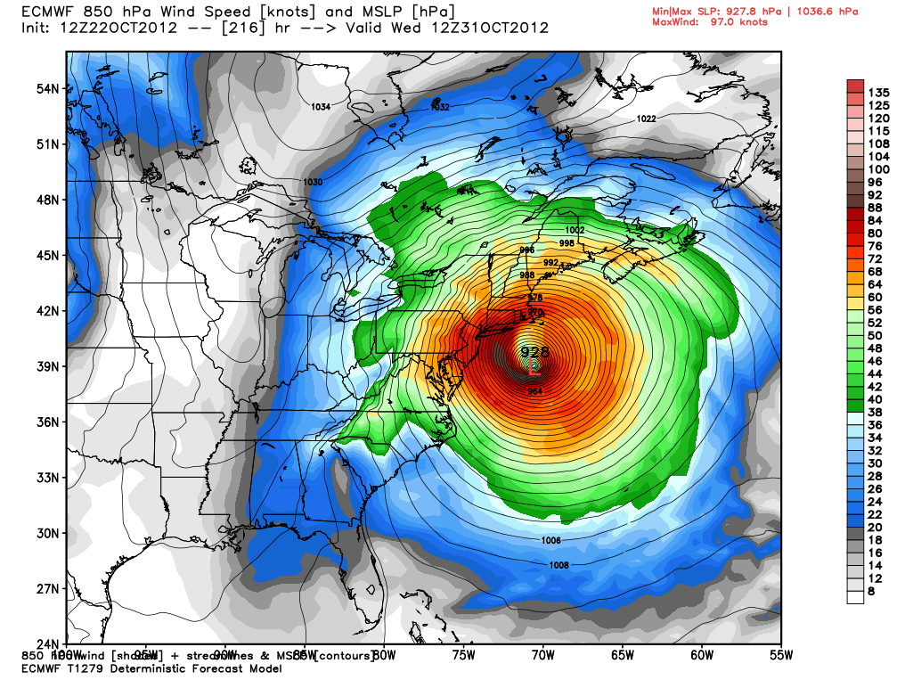
Examples of statistics in action...
Linear and non-linear regression
Probabilistic modeling for motion control
Hypothesis testing, ANOVA
Descriptive stats, visualization
Failure analysis, QA models
Time series modeling, geo-spatial regression

Slide 7
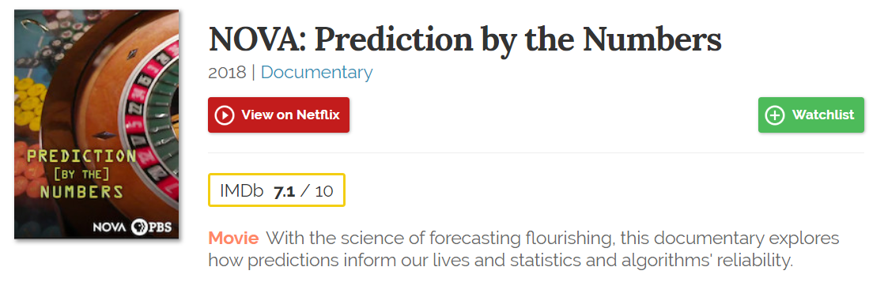
You can watch this documentary on Netflix now

Slide 8

What will we learn in this bootcamp?
Descriptive statistics, and probability basics
Central tendency and dispersions, bivariate analysis
Probability concepts, counting stuff
Statistical distributions - discrete and continuous
Exploratory data analysis (EDA)
Inferential and Bayesian statistics
Estimation
P-values, confidence intervals
Hypothesis testing, ANOVA
Bayes’ rule and its applications
Machine learning and data science applications
Linear regression
Logistic regression
Naive Bayes classification
Clustering and MLE
NumPy
Pandas
Matplotlib
Scipy
Statsmodels
Seaborn
MLR
Scikit-learn

Slide 9
Central tendency and dispersion measures
Dr. Tirthajyoti Sarkar
August 31st, 2019

Slide 10
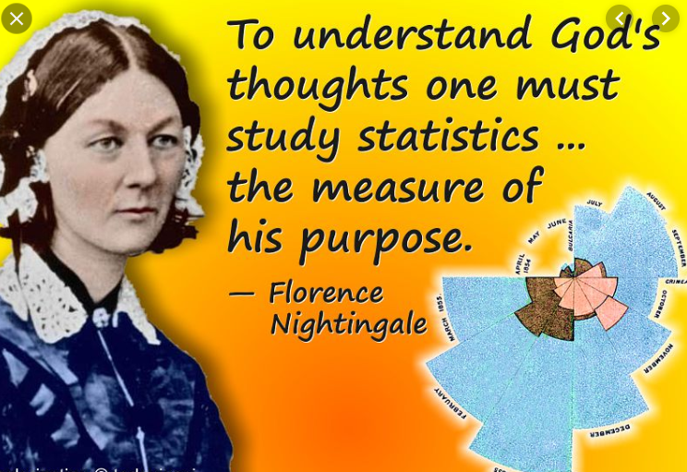
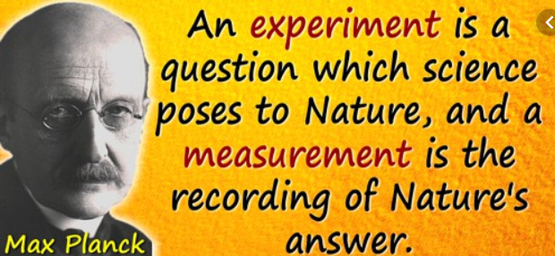
Measure and describe...
Deep scientific thoughts have always been inspired by measuring and analyzing raw data for patterns
Statistics has been serving society centuries before data science took off :-)

Slide 11
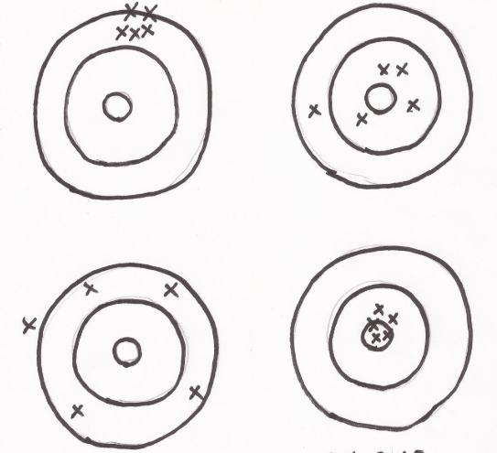
Central tendency and dispersion
There are ups and downs in life. Same for data. There are peaks and troughs but also a baseline.
What is that one number toward which all the measurements tend to gravitate?
But there are enormous variety among datasets. Some look like a close-knit family, others behave like highly dispersed organization.
Need to measure dispersion or spread

Slide 12
Mean(s), median, mode
(Arithmetic) mean: Colloquially called the all too familiar ‘Average’.
Median: The central quantity in a dataset, when it is sorted by (increasing or decreasing) values. Robust to outliers.
Mode: The most frequently occurring data. Mainly useful for categorical datasets.
Geometric mean: Used in special circumstances (datasets where multiplicative growth is observed)
Harmonic mean: Used in special circumstances.

Slide 13
Variance and standard deviation
Variance: A measure of the average (squared) distance of data from their mean value. Squaring is done to turn distance measures positive.
Standard deviation: Just the (positive) square-root of variance to make the quantity comparable to the actual data points in terms of physical units.
These concepts are general. Do not equate them with the ‘Bell curve’. Your dataset may not follow a Bell curve, and you may not be able to apply six sigma techniques but you can always compute mean and variance.

Slide 14
Other descriptive statistics measures
Min and Max: Simple as they sound. Minimum and maximum of a dataset, respectively.
Range: The numerical difference between the Min and Max.
Percentile: It is a measure used indicating the value below which a given percentage of observations in a group of observations falls. For example, the 20th percentile is the value below which 20% of the observations may be found.
Quantile: If a dataset is divided in q equal groups, then it is said to have q quantiles. Median is a 2-quantile. Quartiles are 4-quantiles, etc.

Slide 15
Python coding (head over to the Notebook)
First, we will use rather inefficient but extremely simple code to compute these quantities from a sample dataset.
Why this approach? To be comfortable with mathematical/statistical programming and build a ‘hacker’ mindset.
What if you don’t have access to sophisticated libraries and ready-made routines? Can you still code up a computation from ground up?
Thereafter, we will introduce numerical computing libraries and use out-of-the-box functions/methods.

Slide 16
Bivariate statistics, correlation, plotting
Dr. Tirthajyoti Sarkar
August 31st, 2019

Slide 17
What is bivariate analysis?
As the name suggests, it involves ‘bi’ or two variables.
It has a special place in analytics.
We humans are most comfortable with a X-Y plot. We cannot perceive more than 3-D, and 3-D plots are hard to interpret in most cases. So, a simple 2-D visualization works best for data modeling and analysis.
However, the bivariate analysis goes far beyond just the visualization. It also involves - correlation, simple linear regression, etc.

Slide 18



Keywords: “Population”, “Sample”, “Estimation”
Population represents the entire mass of objects about which some measurement can be made for statistical purpose. Almost impossible to obtain data about.
Sample is a tiny, but fairly representative, fraction of a population, used for actual statistical modeling.
The central goal of statistics is to ‘estimate’ properties of the population by examining the sample - estimation.
Note the parallel to ML - generalization.

Slide 19

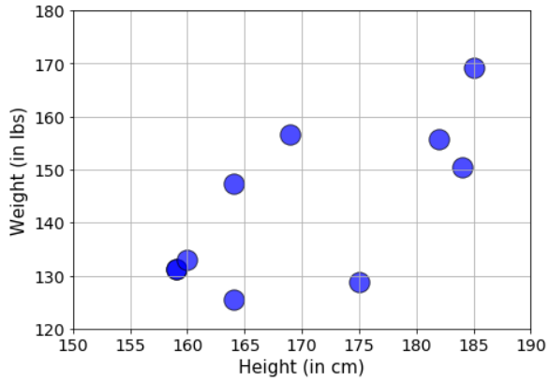
Scatterplot: Bread and butter of bivariate analysis
Is there a ‘relationship’?
Is the relationship linear?
Is there a cause-effect?
Suppose, we want to want estimate the correlation between height and weights of high-school students.
We cannot obtain data for all U.S. high-school students easily/cheaply.
So, we sample from our local school.
Then, we visualize the data in a 2-D plot (shown on the right).

Slide 20
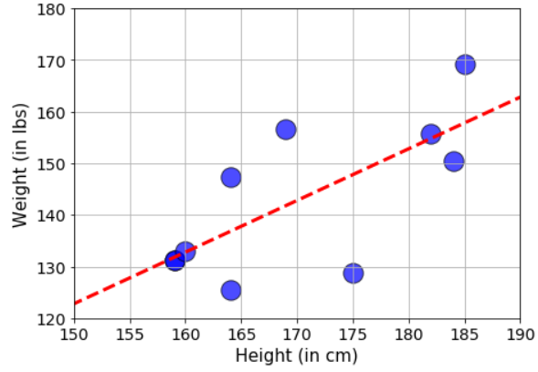
“Fitting the data”: Just a quick view
If we fit a linear model with this sample data, we see the red dashed line shown in the right hand side figure.
Is this line the best we could do?
What does it mean? Can I predict weight given any height data from this line?
Will a jiggly nonlinear fit be better than a simple straight line?
These questions will be re-visited multiple times later and discussed at depth.

Slide 21
Correlation and its measure
At the minimum, even before we do any kind of fitting, we want to do the extent of correlation between the two sets of data points - weight and height.
Being correlated means - moving in the same general direction as the other variable moves. Note it involves direction, so it is like a vector. Its sign matters.
If we see a general increase in weight as the height increases, then we say they are ‘positively correlated’, and the correlation coefficient is a positive number. And vice versa for the negative case.
It is measured by so-called correlation coefficient (ranges from -1 to 1).
Note that, correlation is a strictly linear concept. If y = x², then the correlation coefficient is zero even though y values are completely determined by x.

Slide 22
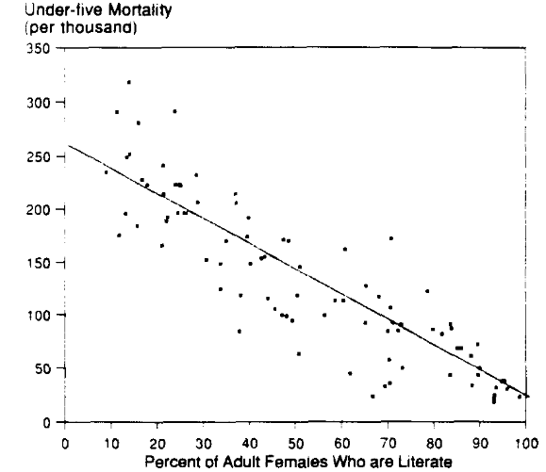
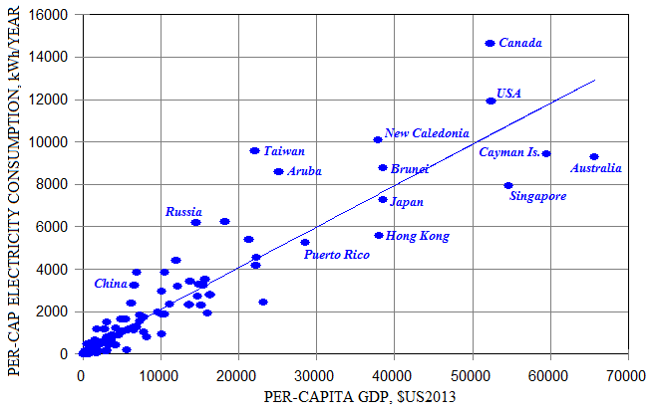
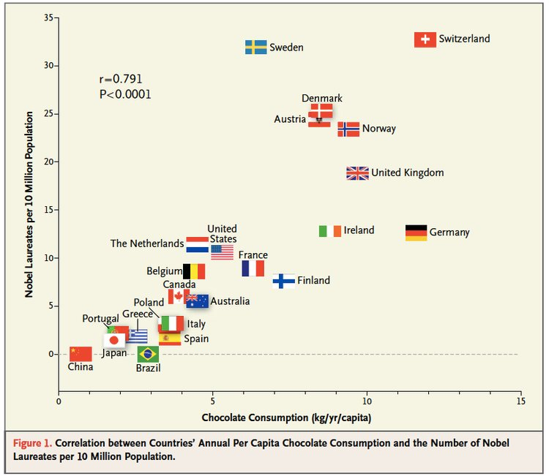
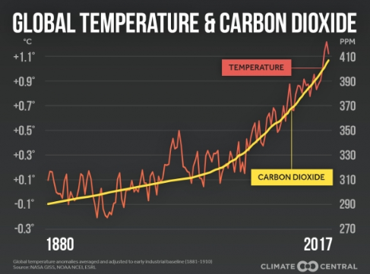
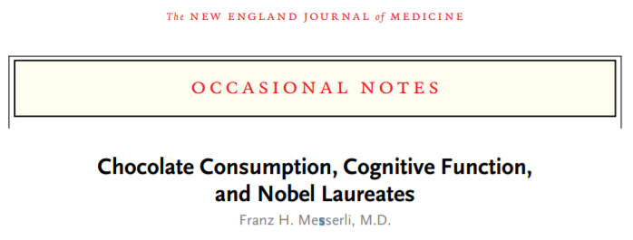
Some simple examples from the real world

Slide 23
Let’s do hands-on coding...
We will go through basics of Numpy library in somewhat more detail.
We will learn how to handle Pandas DataFrame object. This is the most important data analysis library in the Python ecosystem.
We will take a simple dataset and create some scatterplot visualizations using the Matplotlib library.
We will also compute correlation coefficient between pairs of variables. We will use the basic formula and Numpy function.
We will also show how to show the whole correlation matrix when the dataset consists of more than two variables. Will also do a heatmap (using Seaborn library).

Slide 24
Concept of probability
Dr. Tirthajyoti Sarkar
August 31st, 2019

Slide 25

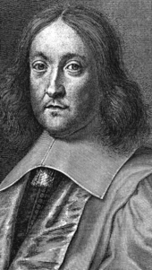
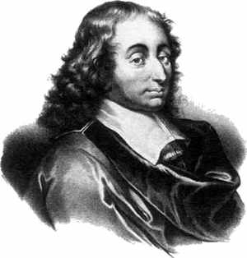
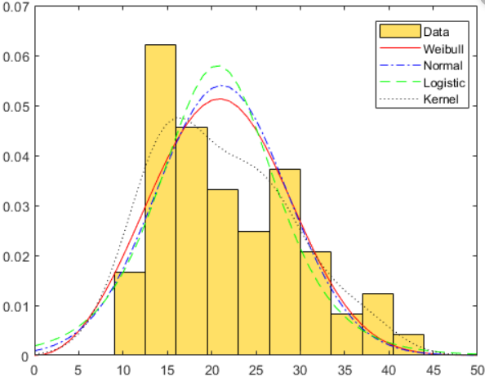

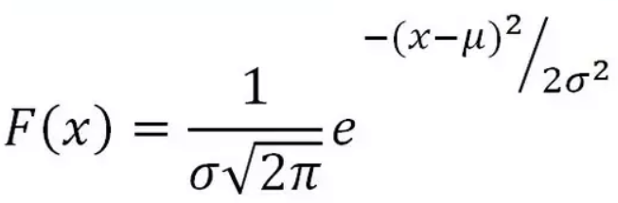
“Greed is Good”
A gambler's dispute in 1654 led to the creation of a mathematical theory of probability by two famous French mathematicians, Blaise Pascal and Pierre de Fermat.

Slide 26
Two camps - frequentists and Bayesians
“Two dice are rolled together. What is the probability of getting a total which is a multiple of 3?”
This problem is solved by Counting. You count and enumerate all the possible outcomes such as {1,1}, {1,2}, {2,1}... {6,6}, then count the number of outcomes where the total is a multiple of 3, such as {1,2}, {2,1}, {2,4}, {4,2}, etc. Then you just take the ratio.
You count and enumerate all the possible outcomes such as {1,1}, {1,2}, {2,1}... {6,6},
Count the number of outcomes where the total is a multiple of 3, such as {1,2}, {2,1}, {2,4}, {4,2}, etc.
Take the ratio
Would Sir Isaac Newton approve this method?

Slide 27

Roll of dice is governed by strict laws of physics
Therefore, in theory, you can precisely calculate the outcome of a dice roll (even if it is loaded or unfair), given its initial position, mass, surface area etc. and the applied force, torque, air friction, etc.
But physics becomes intractable very quickly and first principle calculations are impossible for all but simplest of systems. Therefore, for all practical natural processes, we need a theoretical framework which can work with the inherent uncertainty that characterizes such systems.

Slide 28
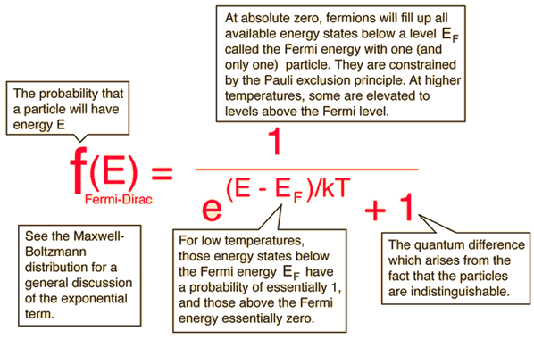
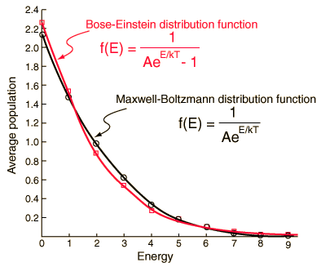
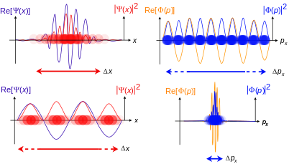
How pervasive is the concept of probability?
Light, heat, energy
Solids, electrons, protons
Wave, particle, all of reality!

Slide 29
Where in data science/machine learning?
Data is inherently noisy and uncertain. But customers want a “confident” answer from you, the data scientist.
Therefore, you must pass the data through the sieve of probability to be able to give some guarantee to your customer.
Probability theory is applied in virtually all machine learning and statistical modeling techniques -
Linear Regression, Logistic regression, Poisson regression
Naive Bayes classification, O/P layer of most deep learning models
Clustering such as k-means
Ensemble techniques such as Random forests, Bagging, Boosting
Language models (NLP), text mining
Advanced AI algorithms - Markov processes, Bayesian networks, Reinforcement learning

Slide 30
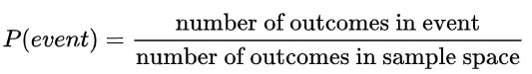
Fundamental definitions and rules
Sample space: Set of all possible events for an experiment/phenomenon.
Event: Favorable outcome that is under investigation. Probability of the event is given by,
Range: Probability ranges between 0 and 1 (inclusive). 0 ≤ Pr(event) ≤ 1
Total: Total probability of all events must sum up to 1.
Joint probability: If A and B are two events, then the joint probability is the probability of them happening together. It is denoted by Pr(A,B).
Independence: If A and B are mutually independent events (one does not affect other in any way), then the joint probability is the product of individual probabilities: Pr(A,B) = Pr(A) x Pr(B)

Slide 31
What will we learn in the bootcamp?
Set theory basics, permutation/combination, and simple probabilities using Python
Random variables, trials, expectation, law of large number
Probability distributions - discrete and continuous, CLT
How probability distributions are used in statistical modeling and inference - F-test, chi-square test, ANOVA
Hypothesis testing, p-values
Conditional probability, Bayes’ rule and its application examples
Circle back to the concept in the context of machine learning algorithms such as linear and logistic regression, k-means clustering, spam filtering, etc.

Slide 32
Random variables, probability distributions
Dr. Tirthajyoti Sarkar
August 31st, 2019

Slide 33
Definitions
Random variable: A variable whose possible values are numerical/categorical outcomes of a random/natural/statistical phenomenon or experiment. There are two types of random variables - discrete and continuous.
Trial/experiment: Scientifically designed test/experiments to measure statistical properties of a population or a natural phenomenon. Often randomized to reduce selection bias and derive causation. Example - clinical drug trial, political polling.
Control group: The control group is defined as the group in an experiment or study that does not receive treatment by the researchers and is then used as a benchmark to measure how the other tested subjects do.
Expectation/Expected value: The expected value of a random variable, intuitively, is the long-run average value of repetitions of the same experiment.

Slide 34

“Law of large numbers”
The law of large numbers (LLN) is a theorem that describes the result of performing the same experiment a large number of times.
According to the law, the average of the results obtained from a large number of trials should be close to the expected value, and will tend to become closer as more trials are performed.
Average (Arithmetic mean)
Expected value
Mathematical definition next page
If we throw dice large number of times, the expected value approaches to the average: 3.5. Note that 3.5 is not the face value of a dice. So, expected value is not the ‘most likely’ or ‘mostly occurring’ values in trials.

Slide 35
Probability distribution
“A probability distribution is a statistical function that describes all the possible values and likelihoods that a random variable can take within a given range.”
Used for statistical inference
Outputs discrete and continuous values
Quantifies uncertainty
Random variable
Maps I/P to O/P
Has a domain of validity

Slide 36
Discrete probability distributions
A discrete probability distribution (applicable to the scenarios where the set of possible outcomes is discrete, such as a coin toss, or a roll of dice, or a quality failure event in manufacturing) can be encoded by a discrete list of the probabilities of the outcomes, known as a probability mass function.
Bernoulli distribution
Binomial distribution
Poisson distribution
Geometric distribution

Slide 37
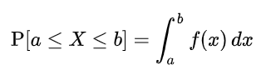
Continuous probability distributions
A continuous probability distribution (applicable to the scenarios where the set of possible outcomes can take on values in a continuous range (e.g. real numbers), such as the temperature on a given day) is typically described by probability density functions (with the probability of any individual outcome actually being 0).
Formally, if X is a continuous random variable, then it has a probability density function ƒ(x), and therefore its probability of falling into a given interval, say [a, b], is given by the integral
Normal distribution
Chi-square distribution
Weibull distribution
Student’s t-distribution
F- distribution
Uniform distribution

Slide 38
Probability mass function
A probability mass function (PMF) is a function that gives the probability that a discrete random variable is exactly equal to some value. The probability mass function is often the primary means of defining a discrete probability distribution.
Example - A fair dice has all 6 faces turning up equal probability of ⅙. On the other hand, a loaded dice may have higher probability of 3 and 6 turning up than the others.
Fair dice
Loaded dice
1
2
3
4
5
6
1
2
3
4
5
6

Slide 39
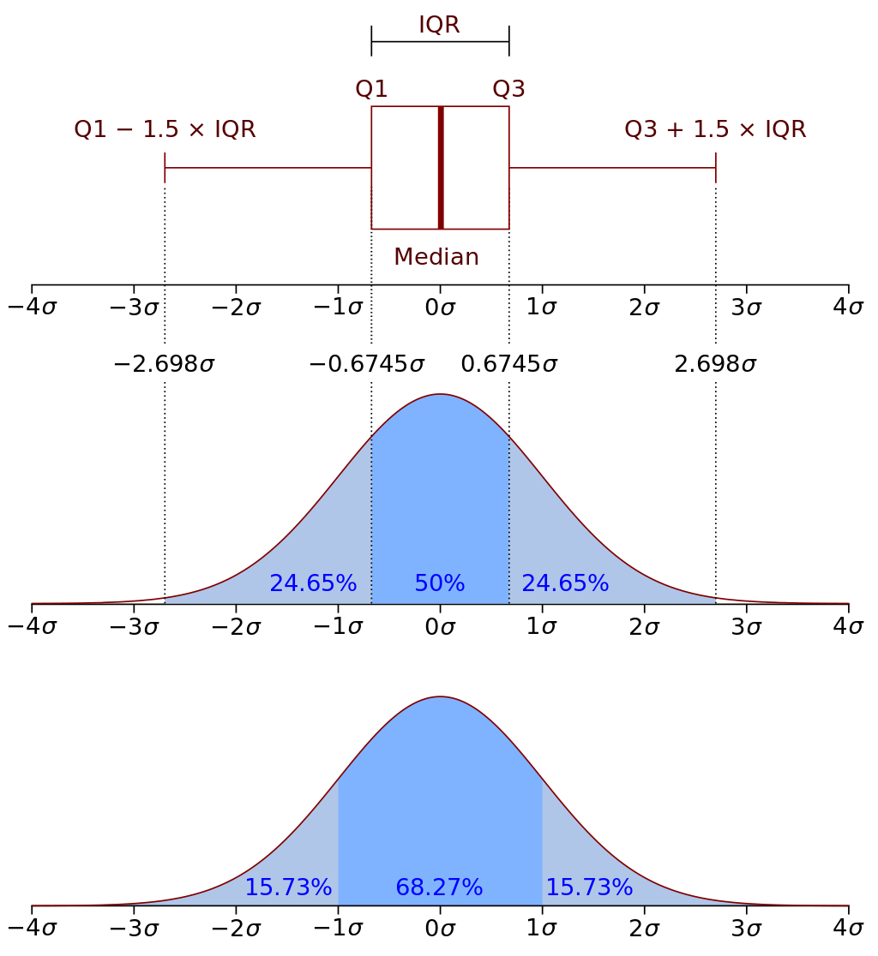
Probability density function
A probability density function (PDF), or density of a continuous random variable, is a function whose value at any given sample (or point) in the sample space (the set of possible values taken by the random variable) can be interpreted as providing a relative likelihood that the value of the random variable would equal that sample.
In a more precise sense, the PDF is used to specify the probability of the random variable falling within a particular range of values, as opposed to taking on any one value.

Slide 40
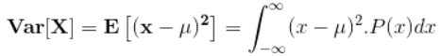
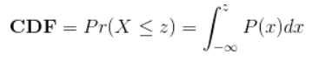
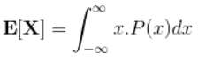
Expectation, CDF, variance, moments
CDF: Cumulative distribution function (CDF) of a real-valued random variable X, evaluated at x, is the probability that X will take a value less than or equal to x.
Variance: The expectation of the squared deviation of a random variable from its mean. Informally, it measures how far a set of (random) numbers are spread out from their average value.
Moments: A moment is a specific quantitative measure of the shape of a function. For probability distributions, they, collectively, determine all the properties. First raw moment is mean, second central moment is variance, 3rd and 4th standardized moments are skewness and kurtosis, respectively.
Expectation: The expected value of a random variable is the long-run average value of repetitions of the same experiment.

Slide 41
Let’s see some examples using Python
We will see how using Scipy/Numpy, we can generate random variables from the following distributions, and what happens when we manipulate them,
Bernoulli
Binomial
Poisson/Exponential
Uniform
Normal
Chi-square
F- and t-distributions

Slide 42
Exploratory data analysis (EDA) for Data Science
Dr. Tirthajyoti Sarkar
August 31st, 2019

Slide 43
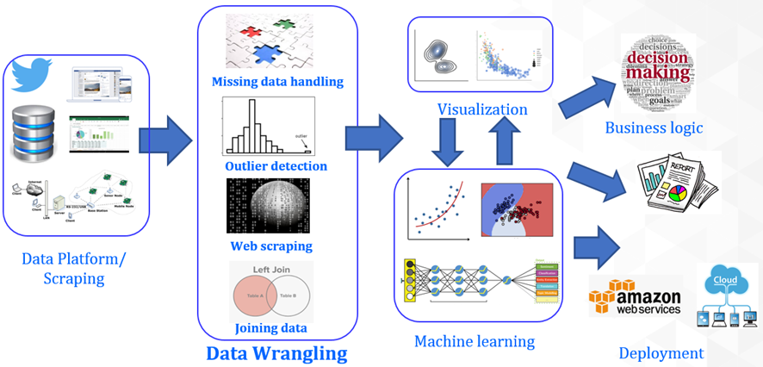
Data wrangling at the forefront
Exploration

Slide 44
EDA: Visualize, probe, detect, summarize
While creating visualizations - think what will bring out the unique characteristics of the data and the business problem.
Do not go fancier than what is needed. Avoid 3-D plots if possible.
Are interactive plots helpful? If yes, add them with minimalistic user controls. But do not create interactive plots with more than one/two controlling variables.
Use plots and charts for probing anomalies and easy-to-find patterns in the data. If something looks odd, probe into the source and cause. Add note, record assumptions, pass on any recommendation up the model chain.
Always try to perform basic descriptive statistics (if the scale allows) to gather numerical scores.
Summarize key insights of EDA, so that machine learning or business intelligence team can have a baseline to start with.

Slide 45
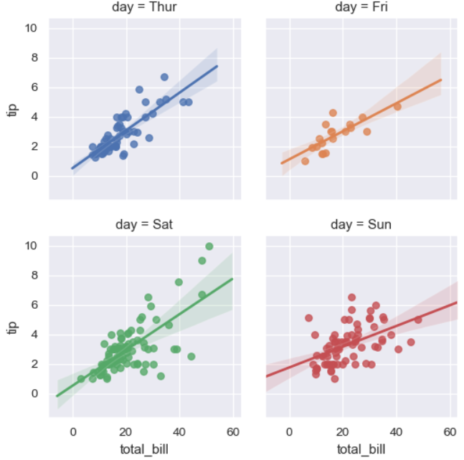
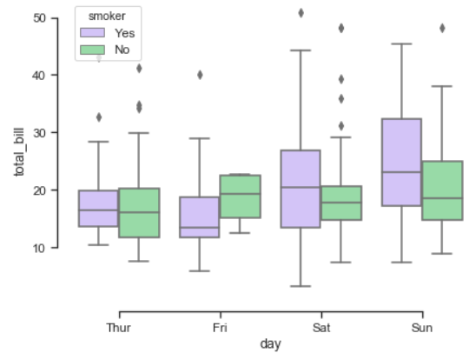
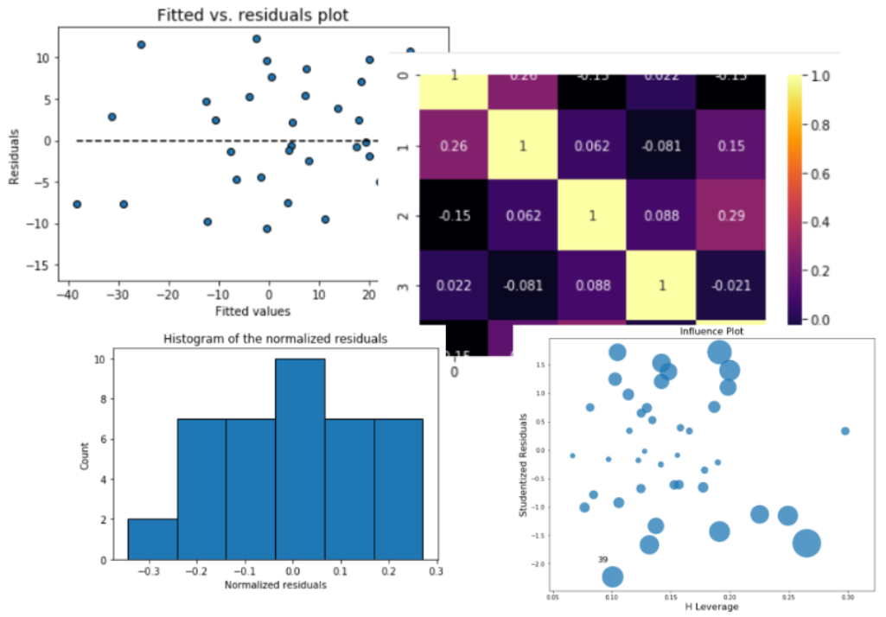
Purposeful plots and charts
Box plots with outliers, aided by color to include multiple categorical variables
Residual plots, histogram, leverage plots with dynamic marker size to show outliers, correlation matrix etc., for a regression problem.
Clean scatter plots in a grid, showing the linear fit and confidence interval

Slide 46
EDA does not have to be a single layer of visualizations
First layer of visualizations, interactive charts
Summary statistics table, basic linear fits, normality checks
Basic outlier detection
Missing value detection and appropriate handling
Standardized feature transformations and 2nd layer of visualizations
Basic tests for compatibility, scaling, ML flow
Summary report/documentation with a statistician’s eye and business analysts’ goal

